Slide 1
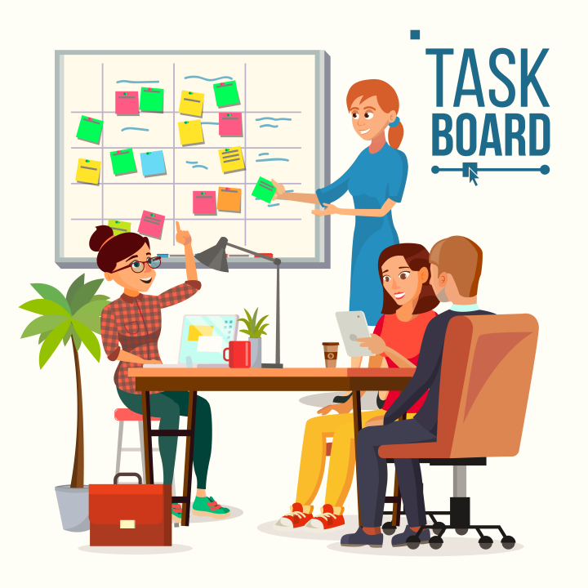
Agile Leadership Unveiled: Crafting Success in Unknown Territories
VATSAL GOHEL

Slide 2
Introduction
Educational Background: Currently pursuing a Master's in Data Analytics at Clark University
Skill Set: Proficient in SQL, Tableau, Python, and experienced in applying agile methodologies through coursework in Agile Software Development.
Professional Success: Awarded the Spot Award at Numerator for effectively managing transitions and consistently fulfilling responsibilities.

Slide 3
Choosing the Right Path: Pitfalls of Waterfall vs. Advantages of Agile
Waterfall
Agile
Inflexibility
Late Customer Feedback
Risk of Project Failure
Long Time-to-Market
Flexibility and Adaptability
Customer-Centric Approach
Iterative and Incremental Development
Reduced Project Risk
Notes:
Drawbacks of Waterfall Method:
Inflexibility: Waterfall follows a sequential, inflexible structure where each phase must be completed before moving to the next. This lack of flexibility makes it challenging to accommodate changes or adapt to evolving requirements.
Late Customer Feedback: Customer involvement is typically limited until the end of the project in Waterfall. This delays feedback, and if there are misunderstandings or misalignments with customer needs, they may only become apparent late in the development cycle.
Risk of Project Failure: Since Waterfall requires detailed planning upfront, any unforeseen issues or changes may only become apparent late in the development process. This increases the risk of project failure, especially if issues are discovered too late to address effectively.
Long Time-to-Market: Waterfall projects often take a longer time to deliver a final product since each phase must be completed before moving on to the next. This extended timeline can result in delays in bringing the product to market.
Advantages of Agile Over Waterfall:
Flexibility and Adaptability: Agile is highly adaptive, allowing teams to respond quickly to changing requirements and priorities. It supports iterative development, enabling adjustments to be made throughout the project.
Customer-Centric Approach: Agile promotes continuous customer involvement throughout the development process. Regular feedback loops ensure that the final product aligns closely with customer expectations, reducing the risk of misalignment.
Iterative and Incremental Development: Agile follows an iterative and incremental development approach, delivering small, functional increments at regular intervals. This enables stakeholders to see progress, make adjustments, and allows for earlier delivery of working solutions.
Reduced Project Risk: By breaking the project into smaller, manageable increments, Agile reduces the overall project risk. Any issues or changes can be identified and addressed early in the development process, contributing to project success.

Slide 4
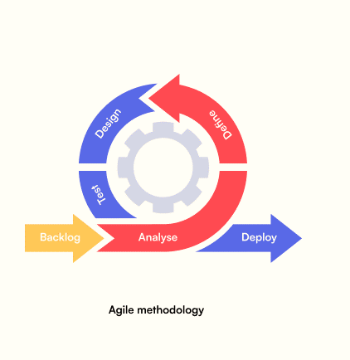
What is agile methodology?
Agile is a project management and product development approach that emphasizes iterative progress, breaking down work into small, functional increments. It enables teams to adapt quickly to changing requirements and deliver tangible value at regular intervals.
Agile is guided by values such as individual interactions, working solutions, customer collaboration, and responsiveness to change, as outlined in the Agile Manifesto.

Slide 5
Benefits of Agile
Flexibility and Adaptability
Improved Product Quality
Increased Team Collaboration
Enhanced Customer Satisfaction
Rapid Adaptation
Transparent Communication
Continuous Improvement
Reduced Risk
Adapting to Market Changes
Early and Predictable Delivery
Notes:
Benefits of Agile:
Flexibility and Adaptability: Agile allows teams to respond quickly to changing requirements and priorities, fostering flexibility in project development.
Enhanced Customer Satisfaction: Continuous customer involvement throughout the development process ensures that the product aligns closely with customer expectations, leading to higher satisfaction.
Improved Product Quality: Incremental development and continuous testing in Agile methodologies contribute to higher-quality end products, reducing the risk of defects.
Increased Team Collaboration: Agile fosters a collaborative environment, promoting effective communication and teamwork, which is essential for project success.
Rapid Adaptation: Agile methodologies enable teams to quickly adapt to changing circumstances and deliver a better product that meets evolving needs.
Transparent Communication: Regular communication and feedback loops ensure that project status and challenges are transparent, facilitating better decision-making.
Early and Predictable Delivery: Agile emphasizes the delivery of small, working pieces of the product at regular intervals, providing stakeholders with early and predictable releases.
Continuous Improvement: Agile encourages a culture of continuous improvement, allowing teams to reflect on their processes and make adjustments for ongoing optimization.
Reduced Risk: By breaking down the project into manageable increments, Agile reduces the risk of large-scale project failure, as issues can be identified and addressed early in the development process.
Adapting to Market Changes: Agile methodologies enable organizations to adapt quickly to changes in the market, ensuring that the delivered product remains relevant and competitive.

Slide 6
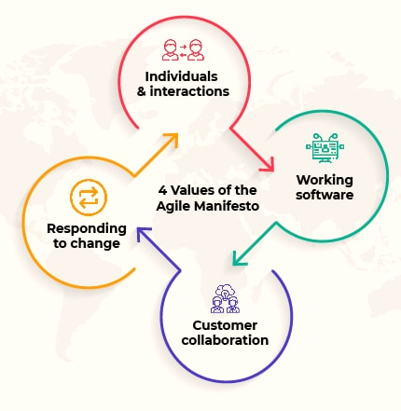
Agile Manifesto
The Agile Manifesto is a set of guiding values and principles for Agile software development. Created in 2001, it prioritizes values like collaboration, working solutions, and adaptability over rigid processes. It encourages a customer-centric and iterative approach to create more responsive and efficient development practices.
Notes:
Core Values of the Agile Manifesto:
Individuals and Interactions over Processes and Tools: Emphasizes the importance of people and effective communication within the development team over relying solely on processes and tools.
Working Solutions over Comprehensive Documentation: Prioritizes delivering a working product and functionality over extensive documentation, recognizing the value of tangible outcomes.
Customer Collaboration over Contract Negotiation: Advocates for active collaboration with customers throughout the development process, valuing their input and feedback over rigid contractual agreements.
Responding to Change over Following a Plan: Encourages adaptability and flexibility in response to changing requirements, acknowledging that plans may need adjustment to meet evolving needs.

Slide 7
Principles of Agile Software
Customer Satisfaction
Changing Requirements
Frequent Delivery
Collaboration Between Teams and Stakeholders
Build Projects Around Motivated Individuals
Face-to-Face Communication
Measure Progress
Maintain a Sustainable Pace of Work
Continuous Attention to Technical Excellence
Simplicity is Essential
Self-Organizing Teams are Key
Regular Reflection and Adaptation
Notes:
Key principles of Agile:
Highest Priority is Customer Satisfaction: Agile prioritizes delivering valuable software that satisfies customer needs. Customer satisfaction is the ultimate measure of project success.
Welcome Changing Requirements: Agile embraces changes in requirements, even late in the development process. It values responding to change over following a fixed plan.
Frequent Delivery of Working Software: Agile promotes delivering working software in small, incremental releases. This allows for continuous feedback and ensures that the product is evolving to meet customer expectations.
Collaboration Between Teams and Stakeholders: Agile emphasizes the importance of individuals and interactions over processes and tools. Collaboration among cross-functional teams and with stakeholders is crucial for project success.
Build Projects Around Motivated Individuals: Agile recognizes the value of motivated and empowered team members. Providing individuals with the resources and support they need fosters a productive and efficient work environment.
Face-to-Face Communication is Essential: Agile values direct, face-to-face communication as the most effective means of conveying information within a development team. This promotes understanding and reduces the risk of miscommunication.
Working Software is the Primary Measure of Progress: Agile focuses on tangible outcomes. The primary measure of progress is the delivery of working software that meets the requirements and expectations of stakeholders.
Maintain a Sustainable Pace of Work: Agile acknowledges the importance of maintaining a sustainable pace of work. Avoiding overwork ensures the long-term productivity and well-being of team members.
Continuous Attention to Technical Excellence: Agile encourages a commitment to continuous improvement in technical skills and processes. Striving for technical excellence enhances the quality of the software being developed.
Simplicity is Essential: Agile favors simplicity in both the development process and the resulting software. Simplicity reduces unnecessary complexity and improves the efficiency of the development effort.
Self-Organizing Teams are Key: Agile trusts and empowers self-organizing teams. Giving teams the autonomy to make decisions fosters innovation and increases ownership of the project.
Regular Reflection and Adaptation: Agile teams regularly reflect on their processes and outcomes. Continuous improvement through reflection and adaptation is crucial for enhancing efficiency and effectiveness.

Slide 8
Building High-Performance Agile Teams: Formation and Structure
Forming an Agile Team:
Agile Team Structure
Define Clear Objectives
Identify Team Roles
Select Cross-Functional Members
Establish Team Norms
Product Owner
Scrum Master
Development Team
Stakeholder Collaboration
Adaptability and Continuous Improvement
Notes:
Forming an Agile Team:
Define Clear Objectives: Clearly outline the project's goals, scope, and expected outcomes to provide the team with a shared understanding of the mission.
Identify Team Roles: Define roles such as Product Owner, Scrum Master, and Development Team members, each with specific responsibilities to ensure a well-defined structure.
Select Cross-Functional Members: Assemble a cross-functional team with diverse skills to cover various aspects of development, fostering a collaborative environment.
Establish Team Norms: Collaboratively set norms and expectations for communication, decision-making, and work processes to create a shared understanding of how the team will operate.
Agile Team Structure:
Product Owner: Responsible for defining and prioritizing the product backlog, ensuring alignment with business goals, and acting as the voice of the customer.
Scrum Master: Facilitates the Scrum process, removes impediments, and ensures the team follows Agile principles, fostering a culture of continuous improvement.
Development Team: Cross-functional members responsible for delivering increments of a working product. They collaborate to complete tasks and achieve sprint goals.
Stakeholder Collaboration: Engage stakeholders throughout the development process to gather feedback, ensure alignment with business objectives, and maintain transparency.
Adaptability and Continuous Improvement: Encourage a culture of adaptability and continuous improvement, where the team reflects on its processes and outcomes in regular retrospectives.

Slide 9
Navigating the Agile Landscape: Types of Agile Methodologies
Scrum
Kanban
Extreme Programming (XP)
Lean
Feature-Driven Development (FDD)
Dynamic Systems Development Method (DSDM)
Crystal
Adaptive Software Development (ASD)
Notes:
Types of Agile Methodologies:
Scrum: A widely adopted Agile framework with defined roles, events, and artifacts. It emphasizes iterative development in fixed-length sprints.
Kanban: A visual management method that focuses on continuous delivery by visualizing work, limiting work in progress, and enhancing flow.
Extreme Programming (XP): Emphasizes technical excellence and frequent releases through practices like pair programming, continuous integration, and test-driven development.
Lean: Based on Lean manufacturing principles, it aims to maximize value while minimizing waste. Focuses on efficiency, continuous improvement, and customer value.
Feature-Driven Development (FDD): A model-driven methodology focusing on features as the primary development unit. It promotes domain object modeling and regular feature updates.
Dynamic Systems Development Method (DSDM): An Agile project delivery framework that emphasizes user involvement, iterative development, and the importance of frequent delivery.
Crystal: A family of Agile methodologies with different characteristics tailored to project priorities, team sizes, and criticality.
Adaptive Software Development (ASD): Emphasizes collaboration and adaptation to changing circumstances, incorporating elements of Scrum, Extreme Programming, and Lean.
Selecting the right Agile methodology depends on factors such as project scope, team size, and organizational goals, allowing teams to tailor their approach for optimal results.

Slide 10
Leadership and Setup: Crafting Effective Agile Teams
Team Leader in Agile
Setting Up an Agile Team
Servant Leadership
Facilitator and Coach
Effective Communication
Empowerment and Trust
Continuous Improvement Advocate
Define Clear Objectives
Identify Roles and Responsibilities
Cross-Functional Team Formation
Establish Agile Processes
Encourage Collaboration
Continuous Learning Culture
Feedback Loops and Adaptation
Notes:
Team Leader in Agile:
Servant Leadership: Embrace a servant leadership style, prioritizing the needs of the team, fostering collaboration, and removing impediments to enhance productivity.
Facilitator and Coach: Act as a facilitator to ensure smooth collaboration and as a coach to guide the team in adopting Agile principles and practices.
Effective Communication: Foster transparent and open communication within the team, promoting a culture of trust and collaboration.
Empowerment and Trust: Empower team members by trusting their capabilities, allowing autonomy in decision-making, and providing the support needed for success.
Continuous Improvement Advocate: Encourage a culture of continuous improvement by regularly assessing team performance, addressing challenges, and adapting processes accordingly.
Setting Up an Agile Team:
Define Clear Objectives: Clearly outline the project's goals, scope, and expected outcomes to provide the team with a shared understanding of the mission.
Identify Roles and Responsibilities: Define roles such as Product Owner, Scrum Master, and Development Team members, each with specific responsibilities to ensure a well-defined structure.
Cross-Functional Team Formation: Assemble a cross-functional team with diverse skills to cover various aspects of development, fostering a collaborative environment.
Establish Agile Processes: Choose an Agile methodology (e.g., Scrum, Kanban) and establish processes for iteration planning, daily stand-ups, and retrospectives.
Encourage Collaboration: Create a collaborative workspace that encourages open communication and frequent interactions among team members.
Continuous Learning Culture: Foster a culture of continuous learning and improvement by providing resources, training, and opportunities for skill development.
Feedback Loops and Adaptation: Implement regular feedback loops and mechanisms for adaptation, allowing the team to reflect on its processes and make necessary adjustments.

Slide 11
Strategies for Agile Success
Embrace a Growth Mindset
Open Communication Channels
Regular Retrospectives
Cross-Functional Collaboration
Prioritize and Adapt
Invest in Team Training
Customer Collaboration
Manage Work-in-Progress (WIP)
Celebrate Small Wins
Lean on the Agile Community
Notes:
Overcoming Agile Challenges:
Embrace a Growth Mindset: Foster a culture of continuous learning and adaptation. Encourage teams to view challenges as opportunities for growth and improvement.
Open Communication Channels: Establish open and transparent communication channels within the team. Encourage sharing concerns, feedback, and ideas to address challenges collectively.
Regular Retrospectives: Conduct regular retrospectives to reflect on the team's performance, identify challenges, and collaboratively devise solutions for continuous improvement.
Cross-Functional Collaboration: Encourage collaboration among team members with diverse skills. Cross-functional teams can bring varied perspectives to problem-solving.
Prioritize and Adapt: Prioritize tasks based on their impact and urgency. Agile teams should be flexible and ready to adapt plans when unforeseen challenges arise.
Invest in Team Training: Invest in continuous training and skill development for team members. Well-equipped teams are better prepared to tackle challenges effectively.
Customer Collaboration: Foster collaboration with customers throughout the development process. Regular feedback from customers can help address challenges related to changing requirements.
Manage Work-in-Progress (WIP): Implement Kanban principles to manage work-in-progress effectively. Limiting WIP can prevent overloading the team and improve focus on high-priority tasks.
Celebrate Small Wins: Acknowledge and celebrate small achievements. Recognizing progress boosts team morale and resilience, helping them overcome challenges with a positive mindset.
Lean on the Agile Community: Leverage the Agile community for support and insights. Learning from others who have faced similar challenges can provide valuable perspectives.

Slide 12


